Slide 1
Perimeter mapping
Perimeter Mapping (2015-16) 50% of the individual ferns with at least 30% dead fronds.
5.1 acres in October of 2015
10.3 acres in October of 2016
= 100% increase
Mapping ceased in 2016

Slide 2
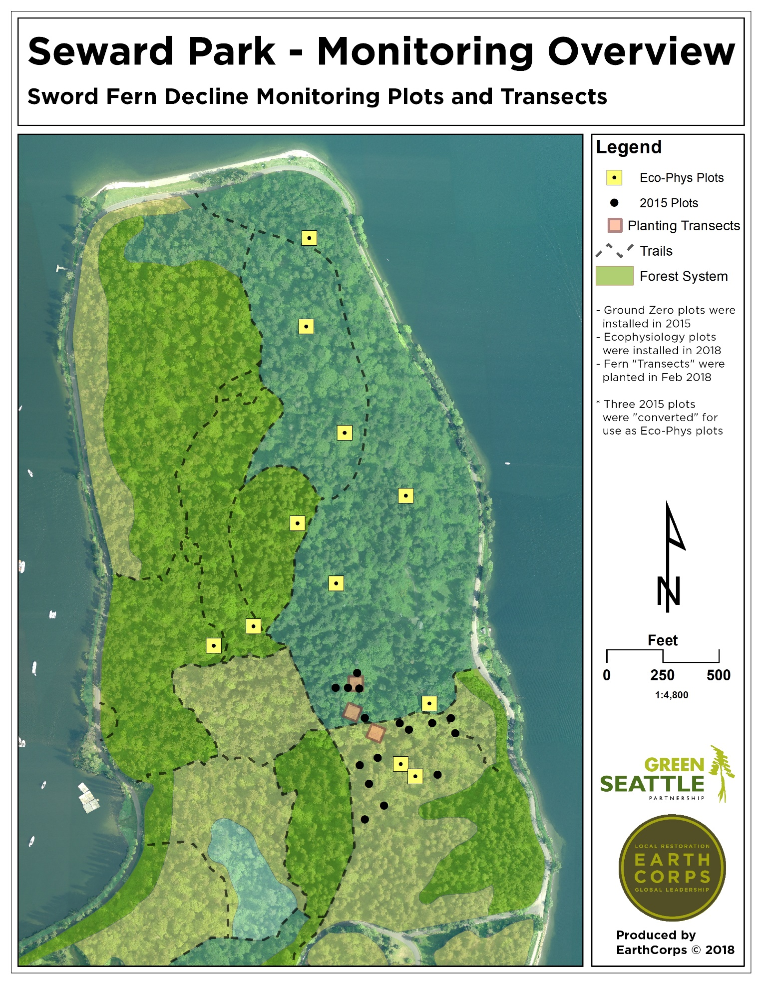
Monitoring Plots (Black dots)
2015 onwards
3m x 3 m
Map and count all ferns live and dead
Classify fronds as dead or alive
Notes:
Black spots are plots my students and I put in in 2015. These are randomly located 3m x 3m plots where we map and count every fern and every frond, and identify the fronds as dead or alive. Any green on the frond = alive. The purpose of monitoring is to track die-off and/or natural recovery over time. We aren’t doing anything experimental.
Everything else on this map is part of an ecophysiology project initiated by Matthew Aghai of Verdant Consulting LLC, along with my students, earlier this year. The idea is to take measures of drought stress, including soil moisture and various measures of chlorophyll production, through the entire growing season. The hypothesis here is that drought stress plays a role in fern death. Planted fern transects were used as controls (assuming that wild ferns are likely to be affected by die-off). If there is greater drought stress in the dying ferns, it suggests a causal mechanism that affects water uptake in the ferns (i.e., something is making them less able to resist drought—perhaps a sucking insect like thrips, or mountain beaver tunneling that leaves rhizomes dangling in mid-air within tunnels—or some other physiological mechanism that damages xylem).
Perimeter mapping.

Slide 4
ANOVA, F = 15.61236, p < .05
F = 15.61236, p < .05
Notes:
F = 15.61236 p < .05

Slide 5
Notes:
120 ferns, 2717 fronds.

Slide 6
Notes:
Red is plot 5, Black is plot 20. Plot 7 is omitted. What is special about these plots?

Slide 7
Notes:
Red is Plot 5, Black is plot 20, Brown is Plot 7. What is special about these plots? Plot 7 is unique in that it has poison oak in it.

Slide 8
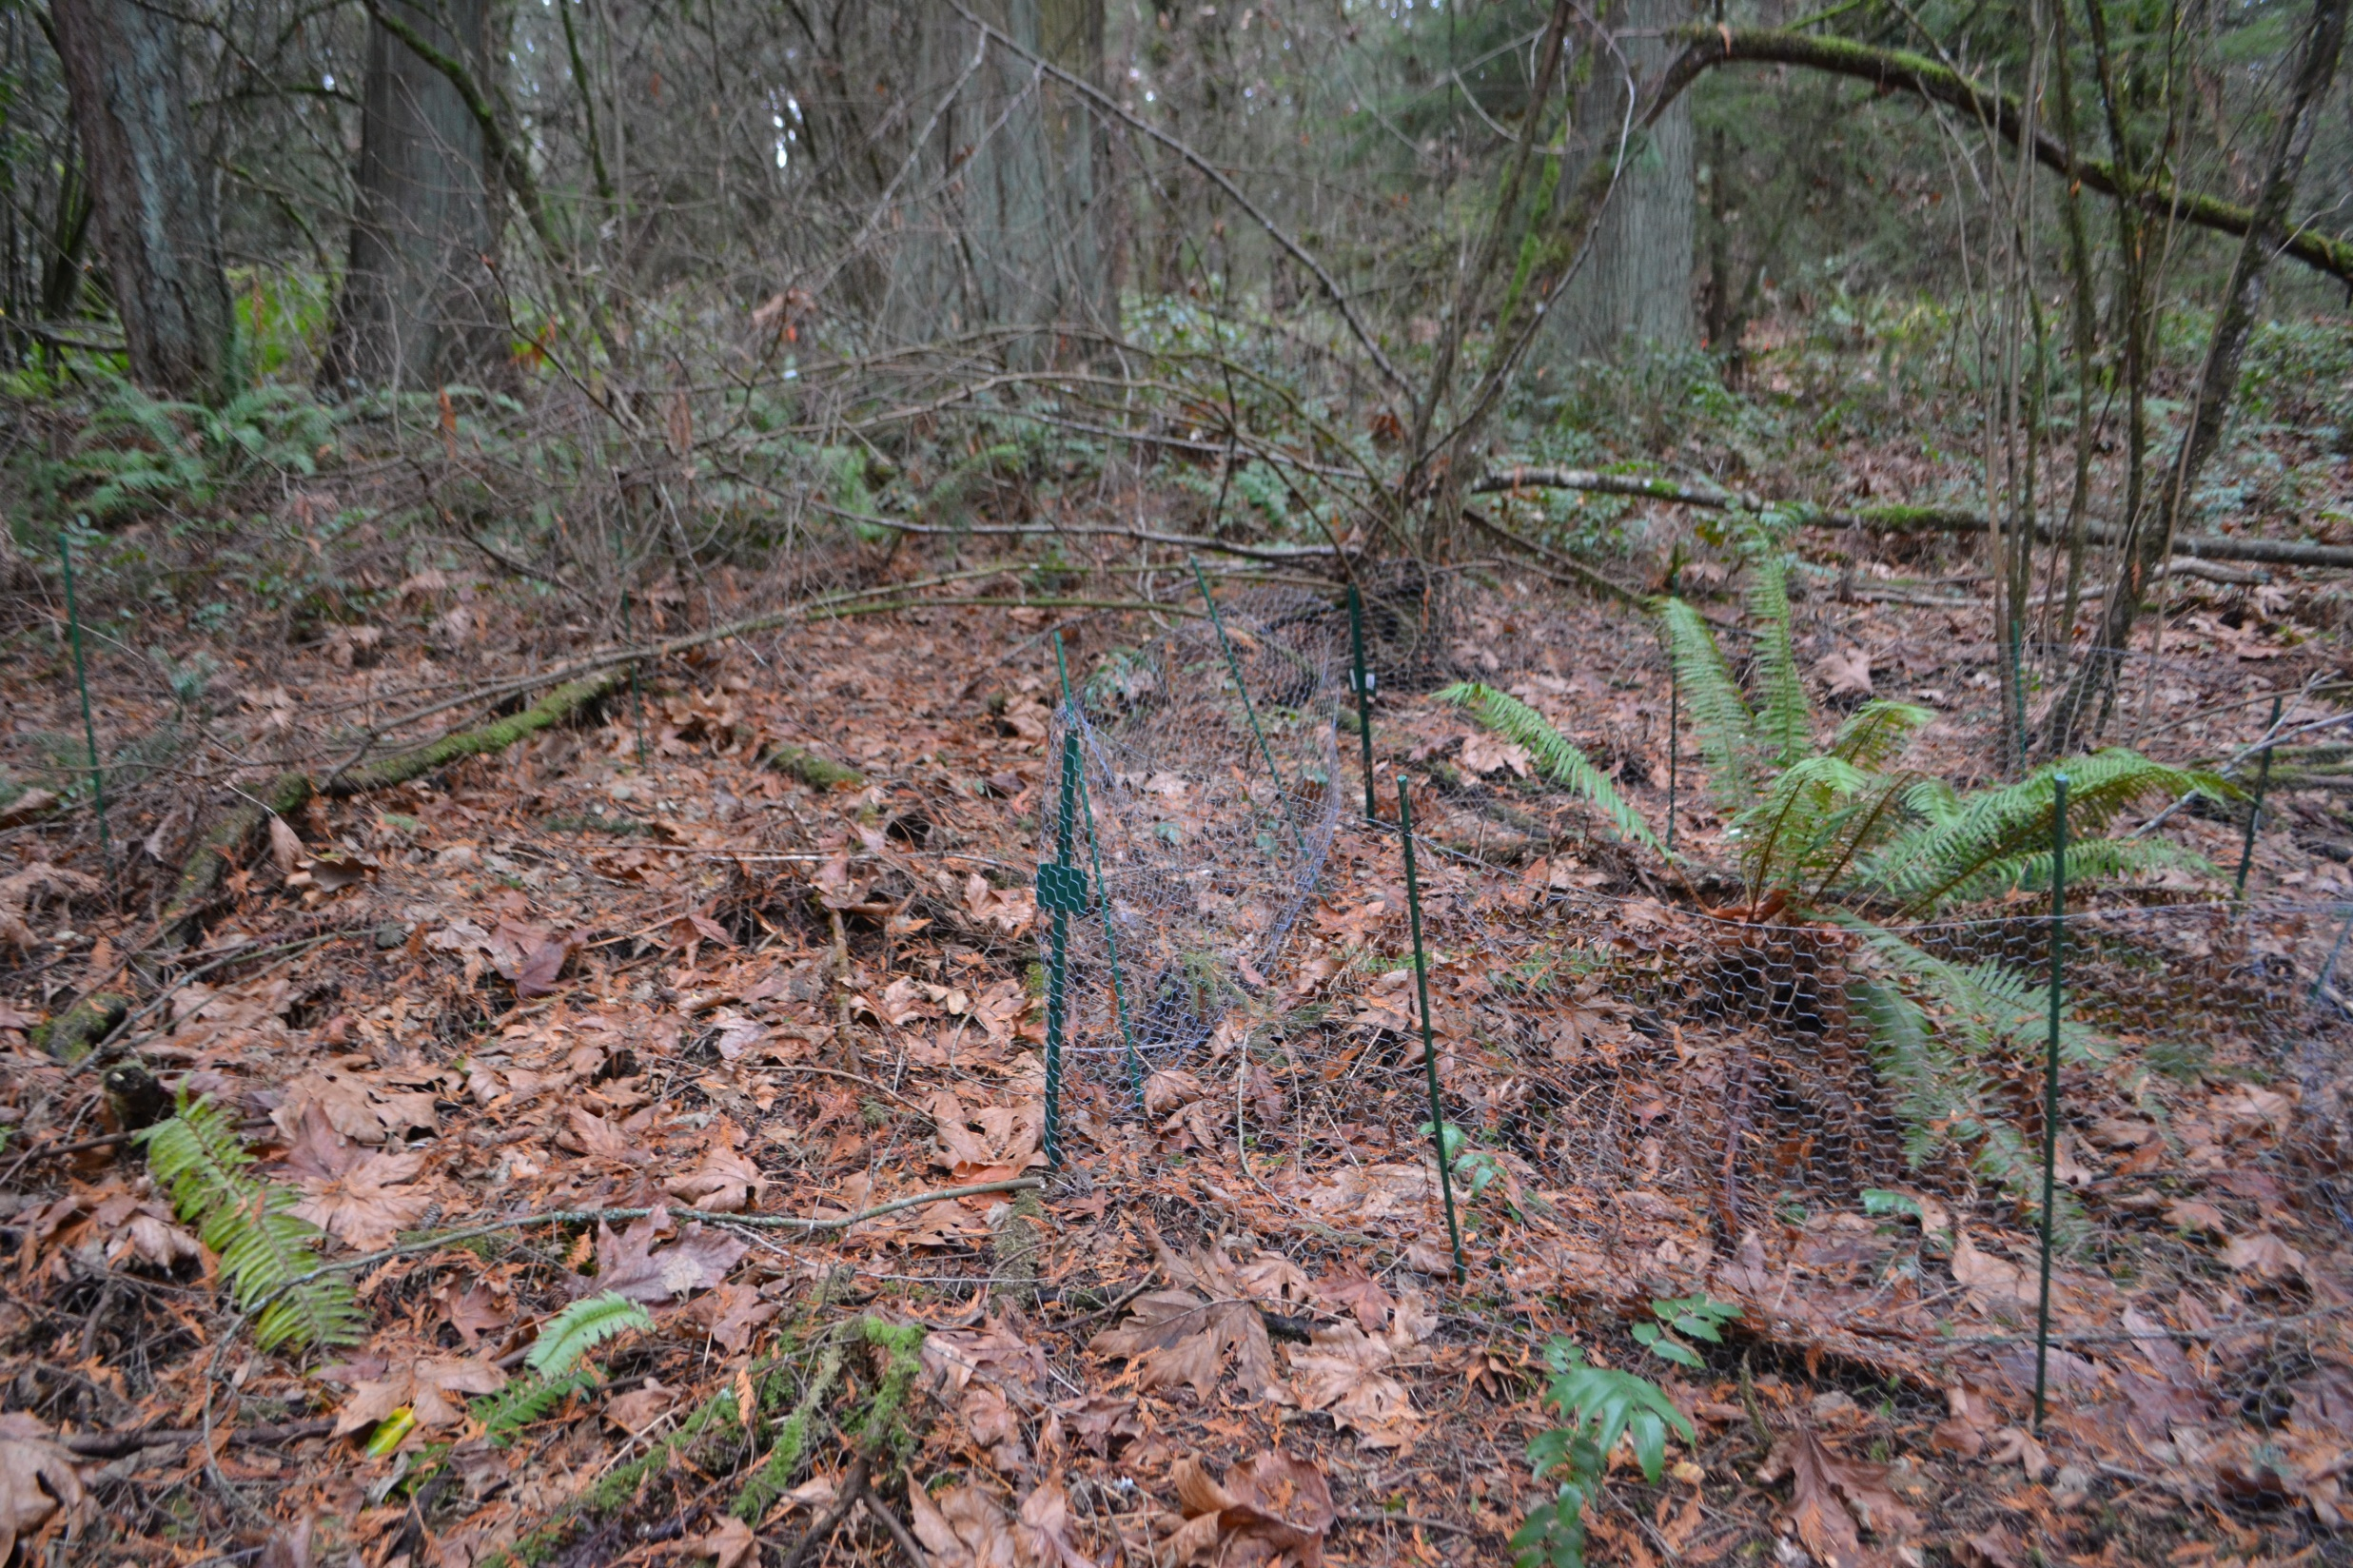

Slide 9
